Slide 1
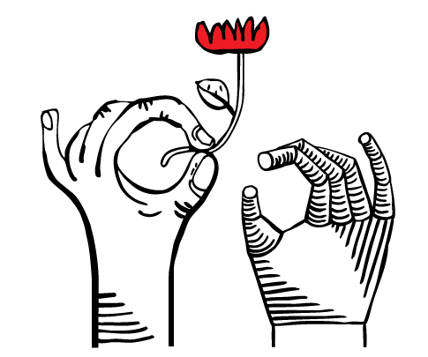
the ART of using AI
"Vibe Coding" & Process Automation
Lana Labadze

Slide 2
Session plan
Part 1
Part 2
Presentation and introduction
Building mini app together with vibe coding

Slide 3
You don’t need to be a developer or IT specialist
ABOUT ME AND AI
My role
What AI lets me do now
I am a manager, not an engineer. I don’t write code by hand.
Build internal tools without waiting for IT
Turn an idea into a working prototype
Automate repetitive admin work
Publish websites

Slide 4
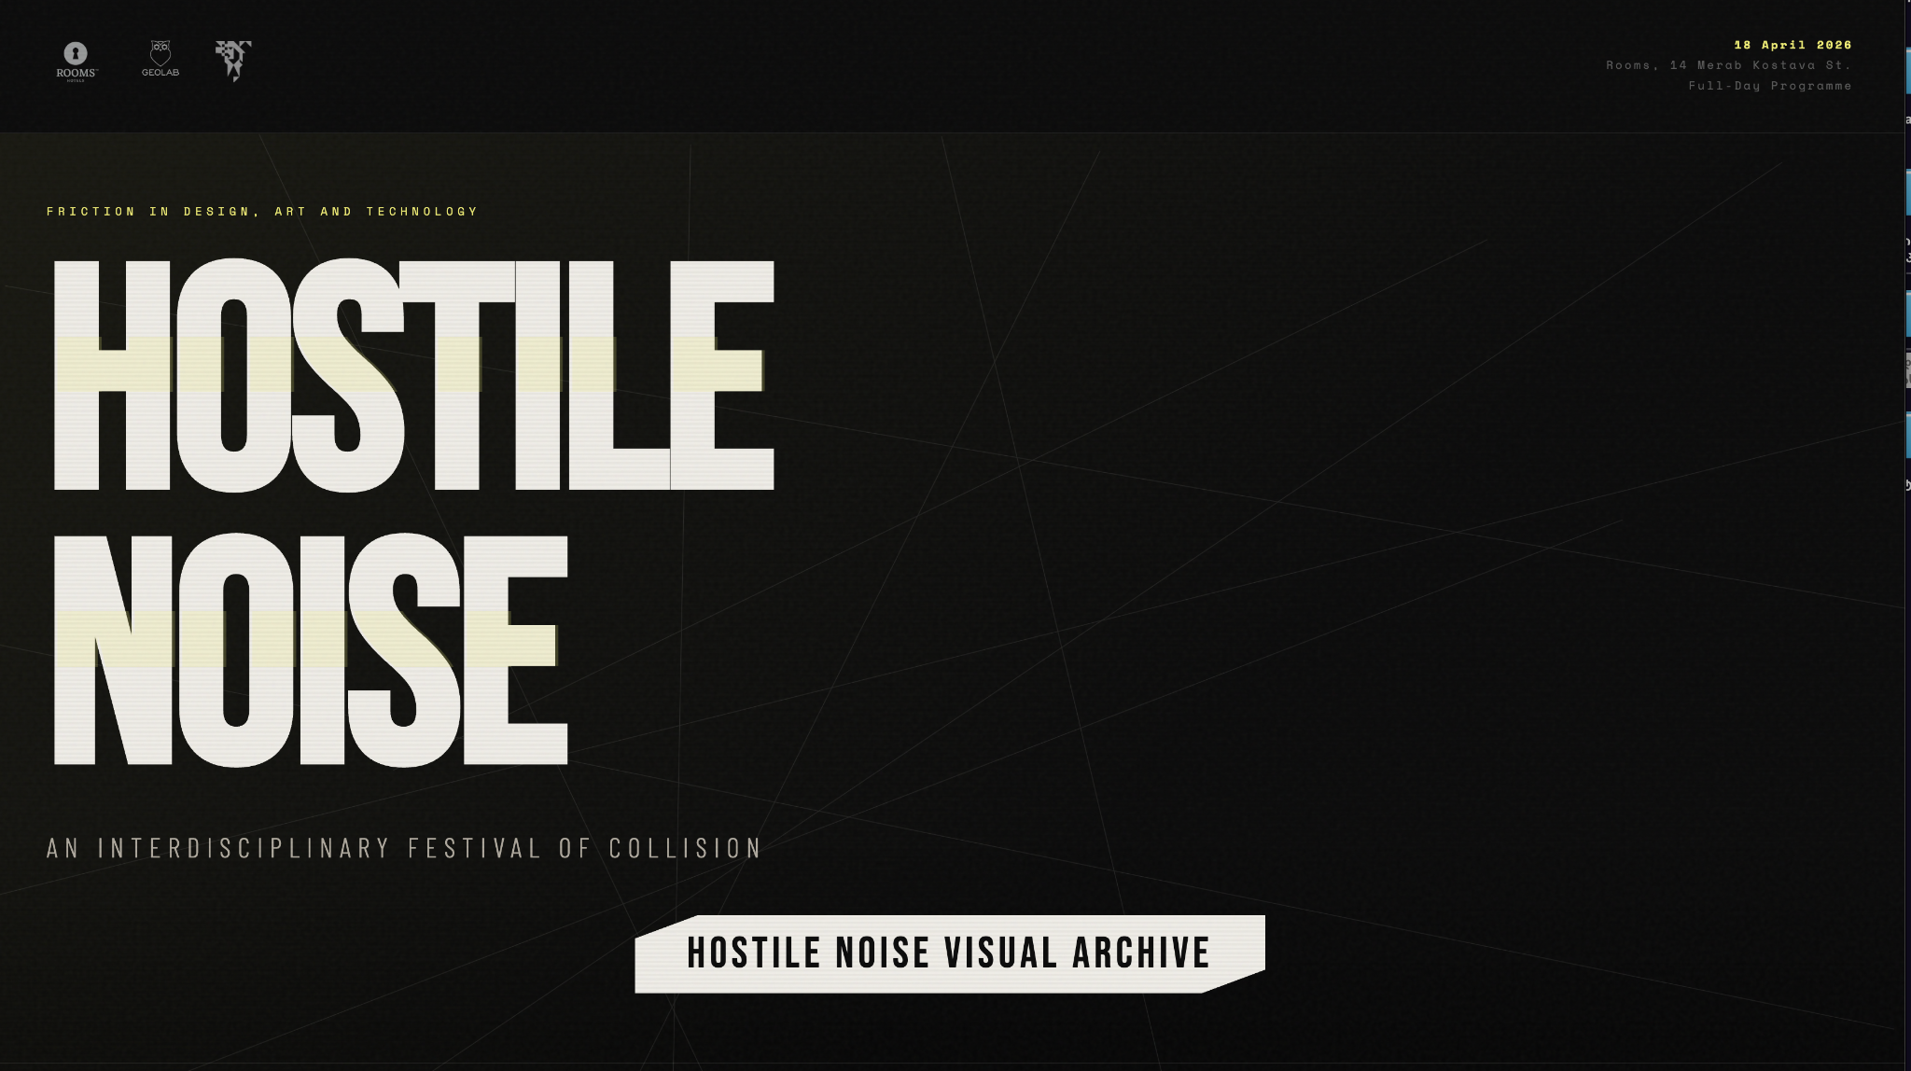
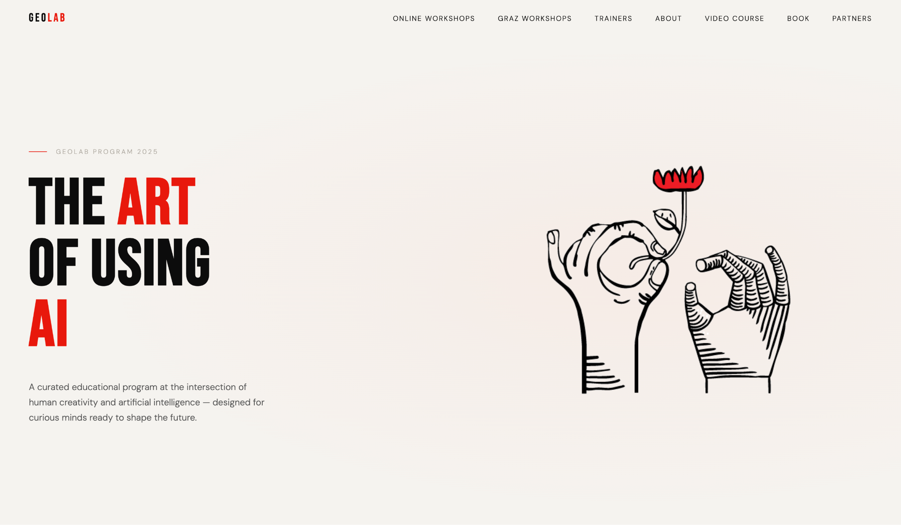
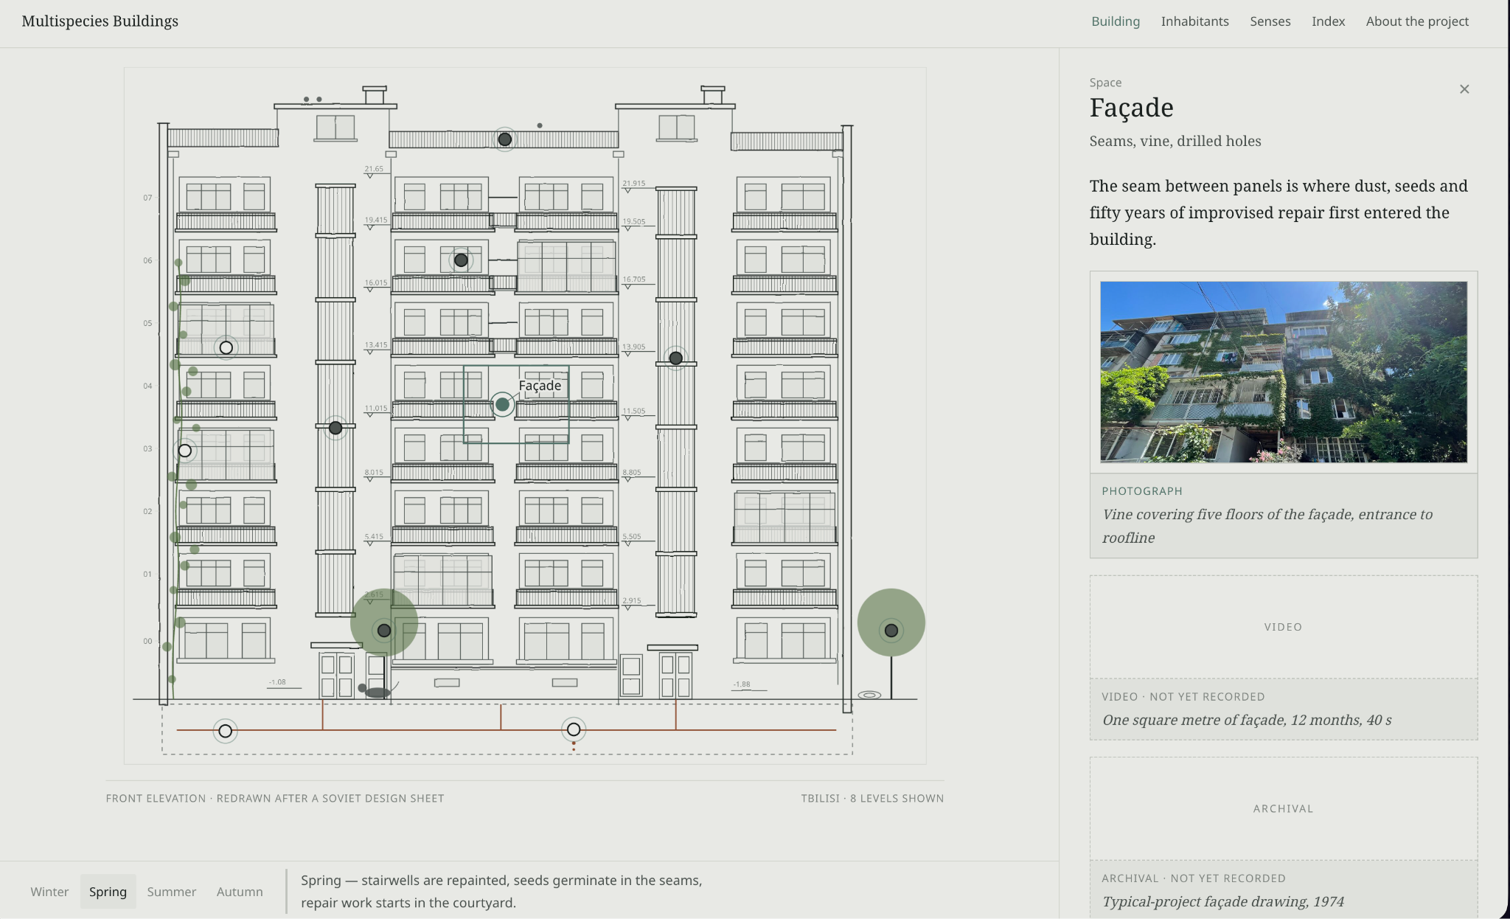
What I’ve built - Web pages
PERSONAL EXAMPLES
Hostile Noise
The Art of Using AI
Multispecies Buildings
Web page for the festival
Web page for the program
Web page for the research project
https://hostile-noise.geolab.edu.ge/
https://www.theartofusingai.com/
https://labadzelana.github.io/multispecies-buildings/

Slide 5
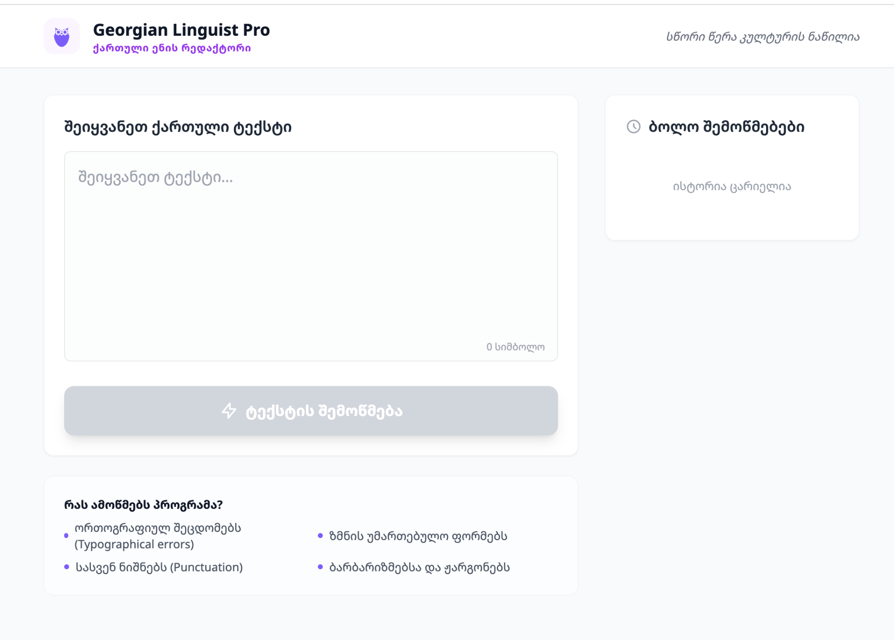
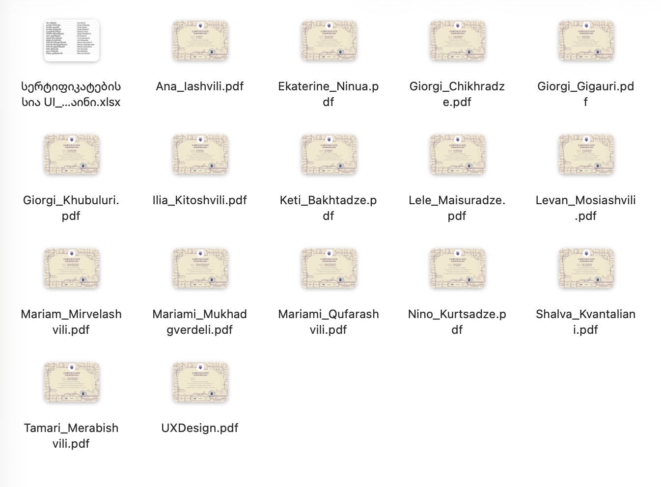
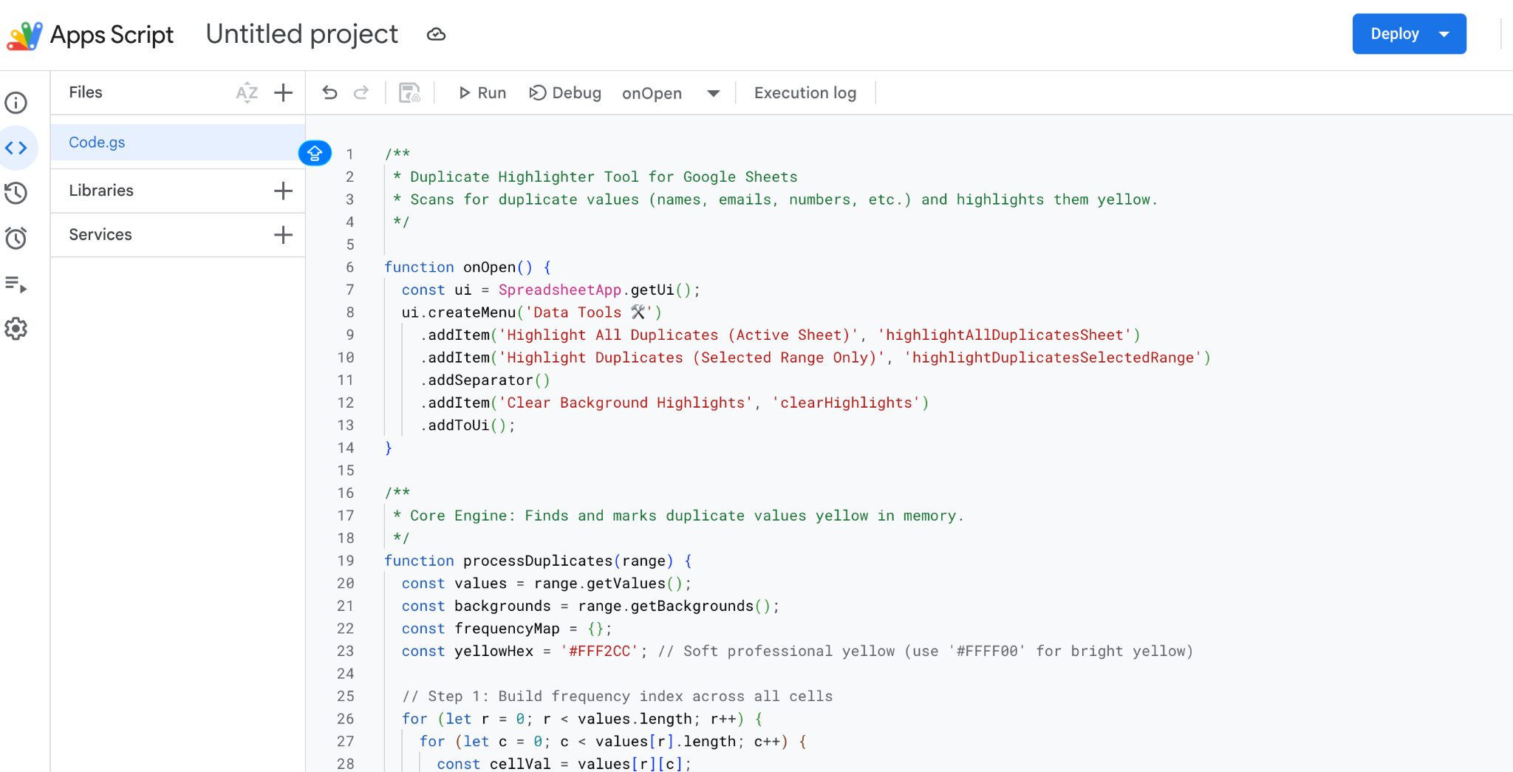
What I’ve built - solutions/apps
PERSONAL EXAMPLES
Spell checker
PDF file generator
App Scripts
For Georgian Language
Program generates certificates
For google workspace
https://ai.studio/apps/cd6f8850-001d-4181-959f-7f50dfb81423

Slide 6
How to manage AI-built solutions
METHOD
Analyze the process
Choose the tool
Build & iterate
What repeats? What takes time? Where is the business pain?
App or automation? Free or paid? Safe to share?
Describe, generate, test, fix. Repeat until it works.
AI writes the code. You manage the process.

Slide 7
What is vibe coding?
THE TERM
You describe what the app should do in plain language. AI writes the code. You test the result and validate.
 | Traditional coding | Vibe coding
You write | Syntax | A description
You need | Programming skills | Clear thinking and testing
First version | Weeks | Minutes to hours
What it is not: one prompt that automates your whole business.

Slide 8
Three tools we will use today
TOOLKIT
Gemini
Antigravity
GitHub
Idea to prompt
Prompt to app
App to shared link
Helps to turn a rough idea into a clear, detailed instruction.
Google’s AI workspace: it writes, runs and fixes the code.
Stores the files and publishes the app as a web page.
https://gemini.google.com/app
https://antigravity.google/
https://github.com/login

Slide 9
What’s public, what’s not
BEFORE YOU PUBLISH
Visible to anyone
Stays in the browser
Check first
The code and the design
Anything written into the code
A Pages site, even from a private repository
No client files left in the folder
No keys or passwords in the code
Company names typed in the form
Uploaded logos
Prices and quantities
The risk is not that the app is visible. It’s what is written in it.

Slide 10
When the tool doesn’t work as expected
KEEP IN MIND
Working with AI tools, the process sometimes stops or the result is wrong. This is a normal part of the work, and the fix is almost always simple.
1. The tool is overloaded and not responding
Google anti gravity and similar tools are often overloaded. Wait a few minutes, refresh and try again.
2. The AI hallucinates
AI can confidently give wrong or invented answers. Verify facts and numbers, clarify your instructions, and ask the AI to correct the mistake.
3. Tokens run out
After a long conversation or a large file, the tool may hit its limit and stop responding. Start a new conversation, briefly summarize what has been done, and continue from there.
Rule of thumb: One tool is never the only way. Try another tool or a different approach.

Slide 11
RISKS & SAFEGUARDS Risks & safeguards checklists
Secrets in code
API keys and passwords in a web page are visible to anyone. Safeguard: keep them out of the code.
Real data in tests
Client logos and PDFs left in the project folder. Safeguard: test with invented data only.
Unchecked output
AI can miscalculate or break a layout. Safeguard: a human checks before anything is sent.

Slide 12
A tailored proposal generator for Companies, with their logo and brand colours.
CASE STUDY AND LET’S BUILD TOGETHER Prompt Library
BEFORE
AFTER
30 minutes
3 minutes
A designer adapts the template
Waiting for revisions
Prices and totals calculated by hand
Upload a logo: brand colours applied
Totals calculated automatically
Ready-to-send PDF in one click
https://labadzelana.github.io/Offer-template-generator/

Slide 13
Build the base
STEP
01
Prepare the folder on the desktop
Open Antigravity and start a new project, attach the folder
Write idea and task you need and give it to Gemini
After Gemini generates prompt paste it into the Antigravity
After the work is done open first version in the browser
Check and test the app.

Slide 14
Improvement
STEP
02
Use second prompt, give the task to allow logo upload and color pallete
After work is complete, test again
Check if everything works and if not continue improvement
Next improvement: PDF download option (in my case it did it itself)
Debugging example: the PDF had extra blank space, so I described the problem and AI fixed it
Again testing and improving

Slide 15
Publish at Github
STEP
03
A ready-to-send proposal, no designer involved.
Open github and register
Create a new Repository, name it same as the folder name, Choose Public
Take the link of the repository and paste it into the Antigravity chat with the command: commit to github your repository link, for example: https://labadzelana.github.io/Offer-template-generator/
Open repository settings - left panel - Pages - Branch - (click) none - (choose) main - (and click) save
Wait few minutes and click visit site and this is app link.

Slide 16
Before you publish
STEP
04
Check list:
☐ No real client files in the folder
☐ No passwords or keys in the code
☐ Repository set to Public: the site will be visible to anyone
shorturl.at/lfmSK

Slide 17
Workshop Materials
shorturl.at/lfmSK

Slide 18
Thank You!
lana@geolab.edu.ge

